Slide 1
Edge API Lifecycle and Tools
Testing & Mocking

Slide 2
Static Code Analysis

Slide 3
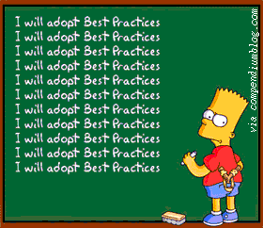
Static Code Analysis
We have the functionality to attach custom code to any flow within Edge. These can be written in Java, JS, Python and Node.js.
Recommendation is to run static code analysis for these custom code in Edge proxy.
Promote consistency and follow best practices for the language you are using.
Notes:
We have the option to write custom extension policies in Apigee using Java, Javascript, Python and node.js.
Use and integrate static code quality checking to custom code written in Edge API Proxies
This is to promote consistency in the codebase and let us follow best practices for the language we are using.

Slide 4



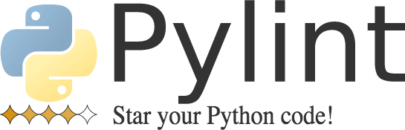

Static Code Analysis
LINT4J

Slide 5
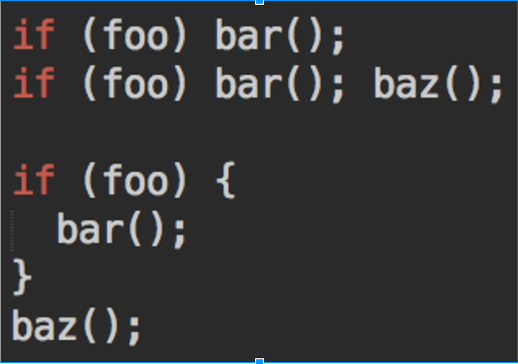
Static Code Analysis
Notes:
Curly braces in block code
JS tools complain if there is an if block without braces even if it has a single line of code in it. It believes it is confusing and will cause hard-to-trace bugs.
My personal feeling is that “there is no good reason not to use braces”. It won’t hurt. But is a personal preference. I think the third block is very clear.
(W116) Expected '{' and instead saw 'bar’

Slide 6
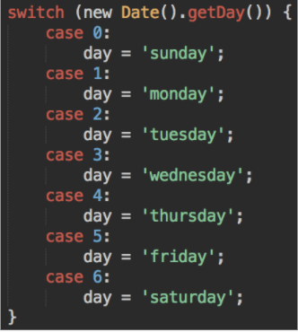
Static Code Analysis
Notes:
(W086) Expected a 'break' statement before 'case’
Best code ever – everyday is Saturday. Because there are no breaks.

Slide 7
Unit Testing

Slide 8
Unit Testing Benefits
code can be tested locally without deployment to Edge first
can create hooks to enforce testing during commit
much faster than integration testing

Slide 9
Unit Testing – Boundary Principal
Test within your boundaries – don’t test libraries you don’t control
Notes:
But don’t test libraries you don’t control. This is better left to the developers who created those libraries.

Slide 10
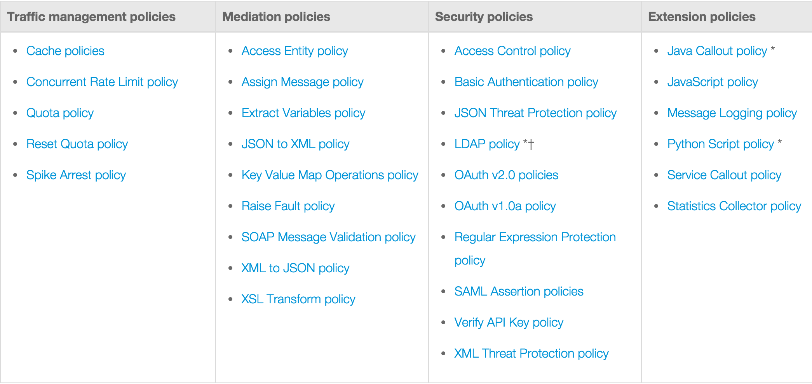
Unit Testing – Types of policies
Notes:
Edge public documentation groups policies in the following categories.
Among these, the functionality for “traffic management”, “mediation” and “security” policies are implemented within the product itself. Code is implemented by Apigee engineering team – you don’t have access to it. Apigee engineering team have extensive unit testing suite for them.
But have a look at “Extension policies” – these policies let you provide custom functionality and extend Apigee proxy. For example JS policy lets you write your own javascript code to do whatever you want to do. These type of policies are candidates for unit testing.

Slide 11




Tools
PyUnit
Notes:
You can write custom code using Java, JavaScript, Python and Node.JS. And these are the policies that are candidates for unit testing.
Alternatives include TestNg, QUnit, Karma, and mockito.
If you can execute all code branches using your integration testing, there might be no need for additional unit testing effort. My recommendation is to analyze the code and see if it can be categories in one of the cases explained, such as Service Callouts to Loggly.

Slide 12
Integration Testing

Slide 13
What to Test
3rd Party
Behavior
Data
3
1
2
Test Runner
Edge
Target Systems
variables
Notes:
What we are looking to do is to test every API resource interaction and we want to assert behavior AND data for each interaction
Examples of behavior is traffic management, OAuth handshake, or a particular behavior of target API or 3rd party API
Examples of data are things like correct error codes, response payload structure or value of individual elements.
Also keep in mind that there might be some scenarios where Edge will respond without request reaching the target systems, e.g. traffic management, OAuth.

Slide 14
Consistent Data
DATA
Can we mock responses at specific points?
Can we do string matching or regex in tests?
Can we recreate data in target systems?
Notes:
The problem is to have consistent data that can be asserted reliably in the tests and it is a pain. The discussions we have with customers are around whether
This happens by CI executing a command on the backend to purge relevant data and reinsert them
The easiest one is to actually use regex instead of asserting for the full data but it is a best practice to mock the target API not only for consistent data requirement but for behavioral testing as well.

Slide 15
API Testing from UI
This is highly not recommended.
This tests the application – not the APIs.
Cannot sufficiently verify all functional paths for the entire API resource space.
Test needs to change when UI changes which is much more frequent than API changes.
The API team needs to be responsible for API testing.
There can be a lot of API clients.
Notes:
There are various reasons for this but most importantly – we may not execute all paths from UI and we don’t want to modify our tests every time UI changes.

Slide 16




Tooling
aPickli
Notes:
Alternatives: Mockito, PyUnit, Jasmine, NSpec, jbehave, specflow, Sinon.JS, mocha, yadda, behad
Use the same tool that you are already using and comfortable with, or consider tools you use In other stages of your development cycle.

Slide 17
Mocking

Slide 18
Benefits
workaround target API availability issues
network, ops, deployment, migrations, patches
parallel development
Workaround constantly changing/unpredictable data
simulate certain scenarios for testing
easy testing when tests rely on previous data population
e.g. forgotten password
improves test execution speed for high latency targets

Slide 19
Implementation
apimocker (node.js) - https://github.com/apigeecs/apigee-apimocker
Amok - https://github.com/sauliuz/amok/tree/master/examples/apigee-amok
import OpenAPI spec and download server code from http://editor.swagger.io/#/
other tools:
Mock Server
Wire Mock

Slide 20
THANK YOU

